Slide 1
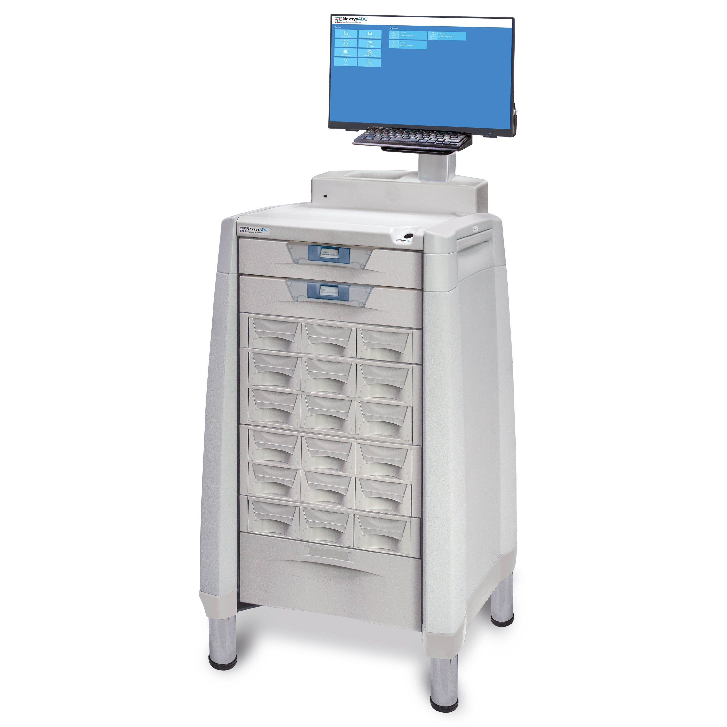


Human Performance Controls Applied to Automated Dispensing Cabinets
by Asha Golveo

Slide 2
Human Performance Controls
Human Factors Human Performance Engineering Optimization
Cognitive Ergonomics
HFE is a discipline concerned with the design of products and systems that reduce human error, improve safety, and increase system performance
The process of applying knowledge, skills, and emerging technologies to improve and preserve the capabilities of military members and organizations to execute essential tasks
The field of study that is focused on the alignment of products and systems with their intended users’ cognitive abilities and limitations. It incorporates knowledge about information processing to improve work systems.
Notes:
The three human performance controls that I’ll be talking about today are Engineering, Human Performance Optimization, and Cognitive Ergonomics
Human Factors Engineering is a discipline concerned with the design of products and systems that reduce human error, improve safety, and increase system performance
Human performance optimization is the process of applying knowledge, skills, and emerging technologies to improve and preserve the capabilities of military members and organizations to execute essential tasks
Cognitive Ergonomics is the field of study that is focused on the alignment of products and systems with their intended users’ cognitive abilities and limitations. It incorporates knowledge about information processing to improve work systems

Slide 3
Automated Dispensing Cabinets
Introduced in hospitals in the late 1980s
Replaced manual systems and medication carts holding individual patient cassettes
Decentralized medication storage – cabinets are stored in the nursing unit for immediate access
Increased efficiency and productivity
Secure medication access – only authorized users can access the cabinet using a PIN or ID badge
Improved usage tracking and inventory management
Integration with ERP and EHR
Doctor
Orders medication
ADC system
Updates inventory and historical record
Pharmacy
Reviews medication
Approves
Nurse
Retrieves drug and administers to patient
Notes:
An Automated Dispensing Cabinet is a computer-based system for the storage and dispensing of medication at a hospital’s points of care such as wards, emergency rooms, and critical care units.
Before ADCs were introduced in the 1980s, hospital pharmacies distributed medication by filling cassettes with unit-dose medications specific to a patient. The cassettes were then delivered to the hospital unit, stored in medication carts, then administered to the patient.
ADCs are located in the nursing ward or nursing unit, where they store and electronically dispense medications offering nurses immediate access to medication at the point of use. ADCs simplify the medication dispensing process, streamlining it for better patient safety and a lower risk of errors
They are generally used in hospitals, pharmacies, and laboratories to improve pharmaceutical safety, minimize errors, and increase efficiency through controlled medication access, usage tracking, and inventory management automation.
They can also be integrated with a hospital’s enterprise resource planning system and electronic health record system

Slide 4
Human Factors Engineering in Automated Dispensing Cabinets
User-Centered Design
Equipment design can influence human performance. A confusing ADC display or storage system can lead to errors, potentially leading to dangerous actions.
Consistent with the mental model of its users. Improve efficiency and safety without straying too far from user expectations.
Physical requirements: location, space, size
Error Resistant
Protect users from making errors
Make it difficult for users to make an error: forcing functions
Design simplicity: reducing options, correct way is the easiest
Error Tolerant
Focus on resiliency in dynamic environments: detection and mitigation of errors
Ensure that potential errors can be recovered from
Minimize the ramifications of human errors
Notes:
Human factors engineering is a discipline that helps improve patient safety and the quality of healthcare by considering human capabilities and limitations when designing products and processes. human factors Engineering is also known as usability engineering and user-centered design
User-centered design is focused on designing work or tasks for people, rather than trying to fit people around the job
Equipment design can influence human performance. A confusing ADC display or storage system can lead to errors, potentially leading to dangerous actions. Failing to use human factors engineering principles in user interface design can potentially harm patients.
Healthcare systems have standards and vocabulary that are consistent throughout the hospital and ADCs should be consistent with the mental model of its users, Improving efficiency and safety without straying too far from user expectations. If a design is intuitive, if it simply ‘makes sense’, then human performance will be improved.
Physical specifications require the consideration of location, space, and size (does the nurse have space to move around while using the ADC, does the cabinet impede others from walking, does the size of the ADC accommodate different heights, and can people maintain good posture)
Error Resistant engineering protects users from making errors such as forcing functions
Design simplicity includes reducing options, the correct way is the easiest
Error Tolerance in engineering focuses on resiliency. Hospitals are highly dynamic environments where focusing on resiliency can be more effective than focusing on error and design efforts before they happen. It ensures that potential errors can be recovered from and Minimizes the ramifications of human errors

Slide 5
Evaluating the Design of Automated Dispensing Cabinets
What tasks will the user undertake?
Nurses will use the computer to find and select a drug, then collect the drug to administer to patient
1
2
3
Who is the user?
Who/what will they interact with?
Nurses
The nurse will interact with the computer system (display, keyboard) and cabinets
Notes:
To evaluate the design of ADCs, we have to ask who is the user, what tasks will the user take, and who and what they will interact with
We know that the users are primarily nurses
Nurses will use the computer to find and select a drug, then collect the drug to administer to patient
The nurse will interact with the computer system using the display, and keyboard which could be a physical keyboard or touch screen. The nurse will also interact with the cabinets

Slide 6
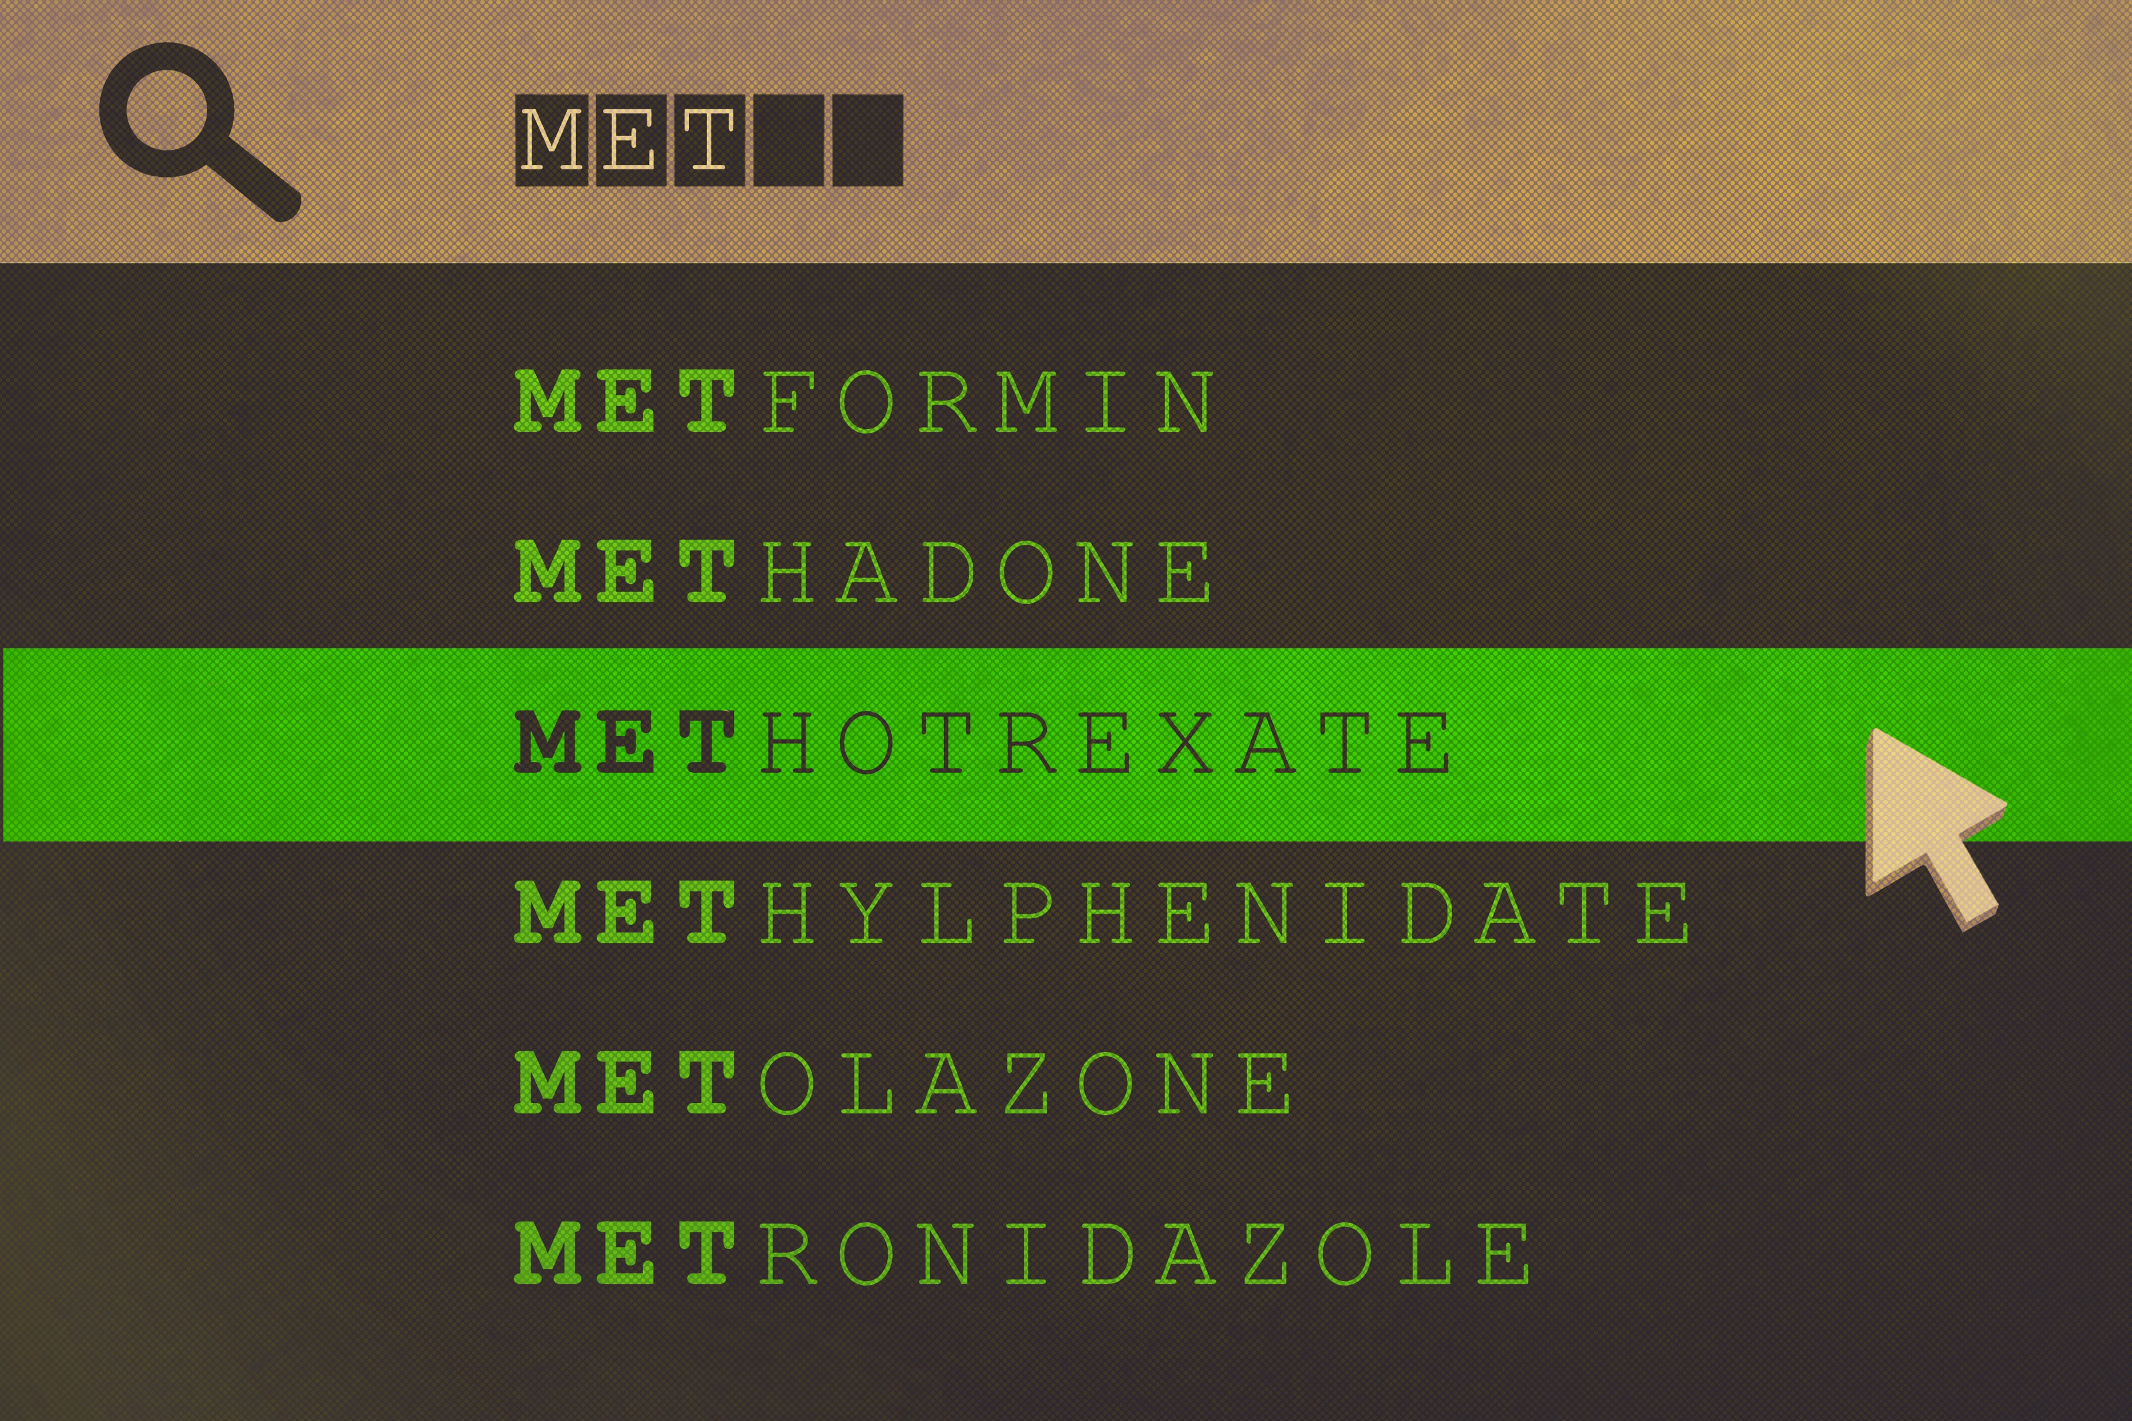
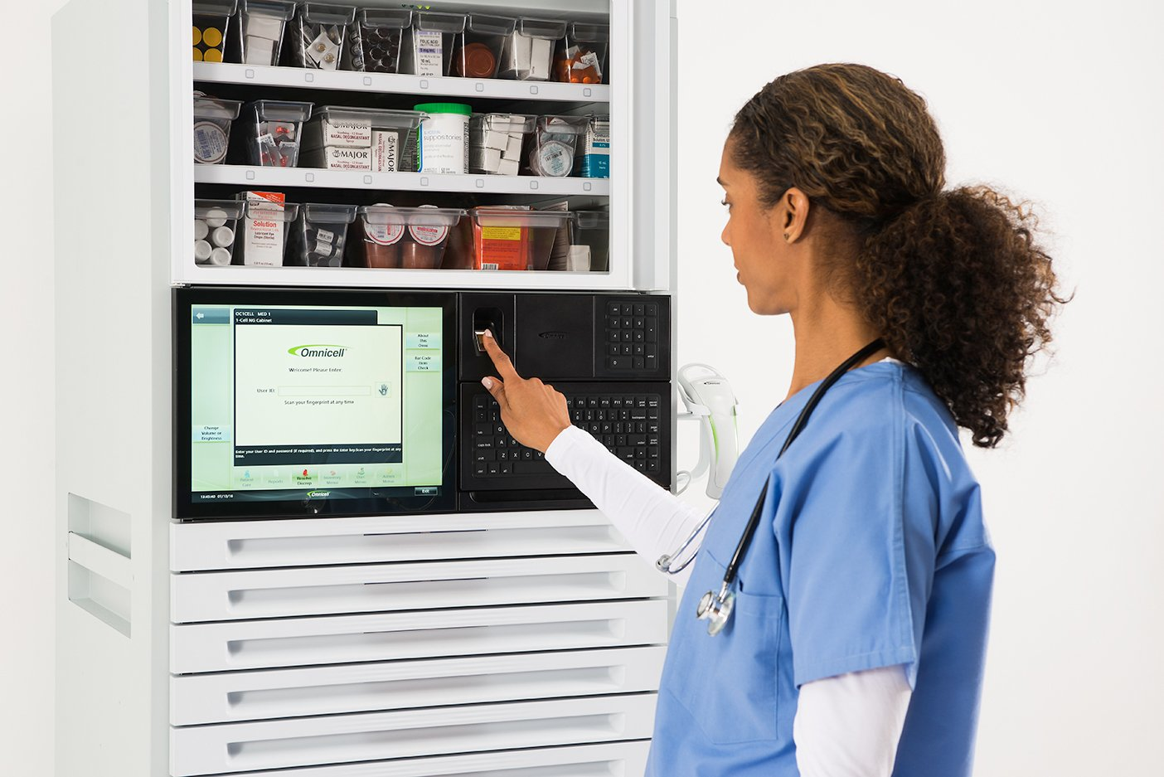

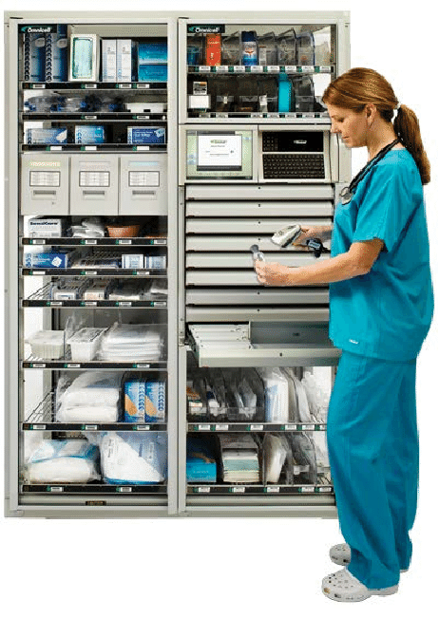
Design Flaws in Automated Dispensing Cabinets
Look-alikes, Sound-Alikes
Overrides
Human-automation Interactions
Configuration
Nurses sometimes choose the wrong drug from the alphabetical list. Some cabinets only require an input of 2-3 characters, leading to quick selections of the wrong drug.
Excessive use of overrides. Nurses use the override function as a workaround to gain access to a drug, sometimes to bypass an error message when drug is not found.
Not all ADCs operate the same way. Each hospital dictates the configuration, implementation, and maintenance.
Overreliance on the ADC system has led to automation bias and complacency.
Notes:
Some design flaws of automated dispensing cabinets are look-alike, sound-alike drugs or LASAs
Look-alike drugs are similar in their packaging, shape, color or size, while sound-alike drugs are similar in the phonetics of their names. When ADCs only require an input of 2-3 characters to search for a drug, it can lead to nurses choosing the wrong drug because of similar spelling or sound.
Overrides are a prevalent issue in hospitals. They are sometimes a necessity in urgent conditions or when there are known issues with the system, but too often they are used as a workaround to gain access to a drug, sometimes to bypass an error message when a drug is not found.
Human-automation interaction issues have also been shown as a problem. A nurse relies on the accuracy of the ADC, leading to complacency and loss of situation awareness. The automation bias results in the nurse missing or ignoring mistakes by the ADC.
Configuration of an ADC is dependent on the hospital’s requirements, integrations, and procedures. An organizational problem will be reflected in the system. Implementation includes training, which affects how well its users understand and operate the system, and some hospitals don’t require barcode scanning, an additional security feature that can catch when the wrong drug is chosen.

Slide 7
Human Performance Optimization
Human Performance Optimization is defined as “the process of applying knowledge, skills and emerging technologies to improve and preserve the capabilities of military members, and organizations to execute essential tasks”
Metrics
Physical fitness
Nutrition
Psychological Fitness
Cognitive Performance
Environment
Sleep
Pain
HPO for Nurses
Nurses would benefit from HPO due to the their highly stressful and complex environment
Physical health of American nurses is often worse than that of the general population
Higher risk of obesity
Occupational safety
Mental health issues
Notes:
Human Performance Optimization is defined as “the process of applying knowledge, skills and emerging technologies to improve and preserve the capabilities of military members, and organizations to execute essential tasks”. The focus is improving and sustaining optimal physical and mental health to reduce human errors, and increase human performance.
The optimization metrics consist of 150 metrics, across multiple domains of physical fitness, nutrition, psychological status, cognitive performance, environment, sleep, and pain.
My research did not find any instances where optimization has been implemented for health practitioners but nurses would benefit from human performance optimization due to their highly stressful and complex environment
The physical health of American nurses is often worse than that of the general population, especially with regard to nutrition, sleep, and physical activity.
Chronic stress can create biological conditions that lead to obesity, such as high-demand, low-control work environments, and long hours which is common for nurses, putting them at higher risk of obesity.
Nurses are exposed to a number of occupational hazards in the workplace, including infectious agents; needle sticks; slips and falls; and injuries due to standing, bending, and lifting patients
Mental health issues, including stress, burnout, and depression, are common among nurses

Slide 8
Cognitive Ergonomics
Cognitive ergonomics examines how human cognition affects interactions with systems in the workplace, with the goal of improving human and system performance
Relevant Topics
Healthcare
Cognitive Load
Mental workload
Decision-making
Skilled Performance
Human-Computer Interaction
Human Reliability
Work Stress
Training
Limited literature on cognitive ergonomics in health care
Nursing requires information processing such as attention, working memory, decision-making, and learning.
Cognitive tasks that exceed the natural limitations of an individual’s cognitive capacity.
Cognitive load found in healthcare settings are distractions, interruptions, inefficiencies, multitasking, and stress
Notes:
Cognitive ergonomics examines how human cognition affects interactions with systems in the workplace, with the goal of improving human and system performance
Relevant topics include mental workload, decision-making, skilled performance, human-computer interaction, human reliability, work stress and training as these may relate to human-system design
There is limited literature on cognitive ergonomics in health care although
Knowledge work jobs such as nursing require high cognitive functioning processes such as attention, working memory, decision-making, and learning.
Cognitive load is caused by the cognitive demands of work tasks which easily exceed the limitations of cognitive capacities.
“Causes of extraneous cognitive load in healthcare include inefficiency, distractions, interruptions, multitasking and stress

Slide 9
Cognitive Ergonomics in Automated Dispensing Cabinets
Multiple studies have shown that nurses believe ADCs have increased their productivity and safety, thereby improving human performance.
2011
2023
Cross-sectional descriptive study: A questionnaire was distributed to 375 nurses, 175 completed the study
Made their work easier (90% level of agreement)
Helped to safely provide patients with care (91%)
Helped to reduce medication incidents/accidents (81%)
Results of a study in 2023 of 166 nurses
81.9% gave a high rate for overall satisfaction
81.3% were highly satisfied with the system's accuracy
74.7% were highly satisfied with the time it takes to complete the task
69.8% thought ADCs are easy to use
79.5% agreed that ADC allowed them to accomplish their job safely
67.4% agreed that it improved their productivity
Notes:
Multiple studies show that nurses believe ADCs have increased their productivity and safety, thereby improving human performance. ADCs are viewed as useful, usable, accessible, credible, and valuable, tenets of good user experience.
Studies from 2011 and 2023 show that overall, nurses are satisfied with ADCs. They feel that ADCs make their jobs safer and help provide safer patient care.Many nurses are able to use ADCs confidently after minimal training, but some say they need more training.
Some cons not reflected in the slide are wait times, which some nurses reporting they having to wait in line to access the ADC, which can be a major difficulty

Slide 10
Cognitive Ergonomics Assessment
Cognitive load is difficult to measure in clinical practice.
NASA-TLX is a widely used assessment tool, measuring perceived cognitive load through self-assessment
Mental demand
Physical demand
Temporal demand
Performance
Effort
Frustration
The four main categories of interventions for healthcare settings:
Cognitive ergonomics in the clinical practice can reduce burnout and improve patient care - reducing errors, redundancy, and inefficiency
Minimize distractions, interruptions, and multitasking
Optimize the use of the EHR
Optimize the use of HIS
Support good communication and teamwork
Notes:
Cognitive load is difficult to measure in clinical practice.
NASA-TLX is a widely-used assessment tool to measure perceived cognitive load and is validated for use in health care workers
NASA-TLX consists of a six-item inventory that asks takers to evaluate their mental demand, physical demand, temporal demand, performance, effort, and frustration when performing a task”
There are four main categories of cognitive ergonomics interventions for healthcare settings:
minimizing distractions, interruptions, and multitasking
Optimizing the use of electronic health records
Optimizing the use of health information systems
Supporting good communication and teamwork
Cognitive ergonomics in the clinical practice can reduce burnout and improve patient care by reducing errors, redundancy, and inefficiency in the health system
That is the end of my presentation. In the next slide I will include my references.

Slide 11
References
National Academies of Sciences, Engineering, and Medicine; National Academy of Medicine; Committee on the Future of Nursing 2020–2030; Flaubert JL, Le Menestrel S, Williams DR, et al., editors. The Future of Nursing 2020-2030: Charting a Path to Achieve Health Equity. Washington (DC): National Academies Press (US); 2021 May 11. 10, Supporting the Health and Professional Well-Being of Nurses.
Li-Wang, J., Townsley, A., & Katta, R. (2023). Cognitive Ergonomics: A Review of Interventions for Outpatient Practice. Cureus, 15(8), e44258. https://doi.org/10.7759/cureus.44258
Wickens, C. D., Clegg, B. A., Vieane, A. Z., & Sebok, A. L. (2015). Complacency and Automation Bias in the Use of Imperfect Automation. Human Factors, 57(5), 728-739. https://doi.org/10.1177/0018720815581940
Grissinger M. (2012). Safeguards for Using and designing automated dispensing cabinets. P & T : a peer-reviewed journal for formulary management, 37(9), 490–530.
Tu, H. N., Shan, T. H., Wu, Y. C., Shen, P. H., Wu, T. Y., Lin, W. L., Yang-Kao, Y. H., & Cheng, C. L. (2023). Reducing Medication Errors by Adopting Automatic Dispensing Cabinets in Critical Care Units. Journal of medical systems, 47(1), 52. https://doi.org/10.1007/s10916-023-01953-0
Kalakoski, V., Selinheimo, S., Valtonen, T. et al. Effects of a cognitive ergonomics workplace intervention (CogErg) on cognitive strain and well-being: a cluster-randomized controlled trial. A study protocol. BMC Psychol 8, 1 (2020). https://doi.org/10.1186/s40359-019-0349-1
Rochais, E., Atkinson, S., Guilbeault, M., & Bussières, J. F. (2014). Nursing perception of the impact of automated dispensing cabinets on patient safety and ergonomics in a teaching health care center. Journal of pharmacy practice, 27(2), 150–157. https://doi.org/10.1177/0897190013507082
Alomair MK, Alabduladheem LS, Almajed MA, et al. Evaluation of the automated dispensing cabinets users’ level of satisfaction and the influencing factors in Al-Ahsa hospitals. DIGITAL HEALTH. 2024;10. doi:10.1177/20552076241264641

